Slide 1
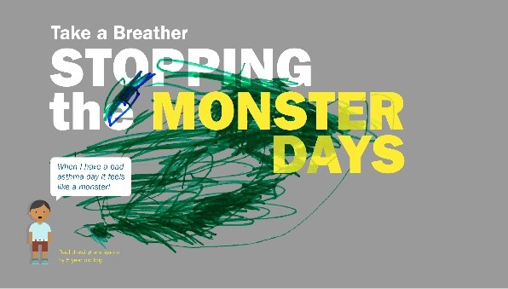
Group Consultations in Schools
Tori Hadaway Specialist Asthma Nurse and Matron of Atopy service Tower Hamlets
Abstract: Asthma is a long-term condition effecting 1 in 11 children and the UK has the highest prevalence of childhood asthma admissions and deaths in Europe. An engagement session identified that children and families would like more interventions in schools. Group consultations in 10 primary schools with 287 children using an interactive presentation, pre and post questionnaires to identify understanding on asthma. They were worried about having an asthma attack and coming to hospital. All participants enjoyed the session with positive feedback and increased knowledge reported. Over half the children did not have a Personalised asthma plan and the correct spacer. Over a quarter of children had poor asthma control, had not had an annual asthma review. Group consultation in schools is a way of increasing asthma awareness and identifies children with poor symptom control and pre-determined risk of having an asthma attack.
Introduction: Asthma is the most long-term medical condition with 1 in 11 children living with asthma and the UK, has the highest prevalence of childhood emergency admissions and death in Europe (1). In Tower Hamlets we have over 1600 visits to hospital with wheeze and asthma each year. A local engaged session with children and families to identify how to improve asthma service highlighted concerns about school’s management of asthma. They were not confident that school had the knowledge and procedures in place to safely mange asthma attacks so did not feel safe sending their child to school. They also wanted more frequent General Practitioner and Hospital appointments out of school hours. Group consultations are a way of bring together individuals with long term conditions to help them manage their own health and share learning experiences (2). Asthma school interventions improves markers of asthma control through education and empowering self-management (3,4).
Stopping breathing
Having an
Asthma attack
Results: Children were worried about:
Positive feedback received with improved knowledge and children and families wanted further sessions at school which would offer peer support..
73% had the wrong spacer effecting correct drug delivery.
60% had no Action Plan which would reduce their risk of admission by 4 folds.
38% had an ACT <19 with at risk of having an asthma attack and 68% of those with poor ACT had not had an annual asthma review.
The aim was to improve outcomes in children and young people (CYP) with wheeze and asthma in Tower Hamlets and to stop the monster days. Our objective was to improve asthma awareness in CYP, parents and school. Identify if it was possible and effective to do group consultations in school. Identify children who are at risk of having an asthma attack with poor asthma control and provide follow up in specialist Asthma clinic.
Group Consultations ​ In School
Method:
A pilot which was carried out on 10 primary schools to 287 CYP, 93 patents and 23 staff. The schools provided a list of all children with a blue inhaler and invited them and their parents to attend a group consultation during school hours. School was asked to have 2 staff present (asthma champions) and provide support for parents who needed translation. A questionnaire was given to pupils and parents to ascertain pre session knowledge on asthma. The pupils were asked what worries them about asthma using worry clouds, which was discussed at the end of session. An interactive presentation was given on what asthma, wheeze and allergy is. Looking at good and poor control, how medication works, triggers, understanding a personalised asthma/wheeze plan and when to seek medical review. Children brought their inhalers with them to aid demonstration of them and identify what spacer they had.
An asthma control test was completed to identify what their control was like. All children with ACT less than 19 were referred to the specialist asthma clinic and parents received a letter on why they were referred. A post questionnaire was given to ascertain what they had learned. Every child was provided with a personalised asthma and allergy plan using GP medical records. A letter was sent to the GP for all children who had an inappropriate spacer. CYP, parents and asthma champions were given a certificate of attendance and an information leaflet, which included all the information discussed in the session. ​
​
Conclusion: Group consultation identifies children with poor symptom control and pre-determined risk of having an asthma attack. It improves awareness on symptoms control and when to seek medical review to reduce risk of an attack and hospital admission. It supports the national asthma bundle
and The coreplus5 approach in reducing health inequalities and improving asthma
care in children (5,6).
Plans: Funding has been agreed to expand the service to an Atopy service
to deliver group consultation and Asthma Friendly schools in all Tower Hamlet schools.
References:
1 https://www.england.nhs.uk/childhood-asthma/
2 https://www.england.nhs.uk/childhood-asthma/3 NHS England » Group consultations: Together, patients are stronger
3 https://www.rcplondon.ac.uk/projects/national-review-asthma-deaths
4 Report template - NHSI website (england.nhs.uk)
5 NHS England » Core20PLUS5 – An approach to reducing health inequalities for children and young people
6 https://www.england.nhs.uk/publication/national-bundle-of-care-for-children-and-young-people-with-asthma/

